Slide 1

Introduction Git
Armando Antonio

Slide 2

Agenda
What is a Git?
Setup Git
Initial Repository
Make Changes Working Area / Staging Area and Commit
Git status
Unstage Change
What is a Branche?
Switch to, create, delete, and rename branches.
Git Log, Git Log –online
Update Local Repository
Git Pull vs Git Pull Rebase
Rebase Benefits
How rebase code without using git pull –-rebase?
Create Commit
Update Commit Message
Undo Commit
Soft and Hard Resert
Git Merge
Git Squash
Git Rebase –interactive
Cherry Pick
Git Reflog
Push / Push –f
Amend (Add Files)
25. Merge vs Fast-forward Merge vs Rebase
When does a fast-forward merge occur?
When is a fast-forward merge not possible?
What is the result to the “main” branch after a non-fast-forward merge?
What to do when a conflict occurs?

Slide 3
1. What is git?
Git is a free and open-source distributed version control system designed to handle everything from small to very large projects.
Git allows to have a complete history of our code.
git works in a decentralized way, meaning each developer has a copy of the code.

Slide 4
2. Setup Git
Commands | Description
git --version
git config --global user.name "Your Name" | Configure global username and will be used in your commits.
git config --global user.email your.email” | Configure global user email and will be used in your commits.
git config --global core.editor "'C:/Program Files/Notepad++/notepad++.exe' -multiInst -notabbar -nosession -noPlugin" | This sets the default editor for Git. In this case is Notepad++.exe. These are additional flags to ensure Notepad++ opens a new instance without tabs, previous sessions, or plugins: -multiInst -notabbar -nosession -noPlugin
git config –-global –-edit | Verify the configuration. This will open the global Git configuration file in Notepad++ if the setup is correct.
WINDOWS: git config --global core.autocrlf true MAC: git config --global core.autocrlf input | This is useful if you are working on Windows or Unix-based to ensure that line endings are handled correctly across different environments.

Slide 5
3. Initialize Repository
Description:
Initialize a new Git repository in your project directory.
mkdir my-project
cd my-project
git init //Secrea la carpeta oculta .git
ls .a // muestra los archivos de git.
Command:

Slide 6
4. Make Changes Working Area / Staging Area and Commit
Working
Directory
Stage
Area
Commit
Local Repo
Server
Remote Repo
git add .
Or
git add “file-name”
git commit –m “message”
git push
File Change
File Change
File Change
File Change
git restore –-staged <file-name>
File Change
Command | Description:
git status | Use to see with files have been modified or in staging area.
git add <file-name> | Use to add specific file to Staging area.
git add . | Use to add all changes to staging area.
git commit -m “Commit message” | Use to commit the changes from the change from the staging area to the repository.
git restore --staged <file-name> | Use to Unstage specific file to staging area.

Slide 7
5. Git Status
Description:
Check the status of your working directory and staging area.
Command:
git status
Scenarios
Before Committing Changes | To see which files have been modified, added, or deleted since the last commit.
After Adding Files | To confirm that the files you added with git add are staged for the next commit.
After Pulling Changes | To check if there are any conflicts or changes that need to be resolved.
Before Pushing Changes | To ensure that your local repository is in sync with the remote repository.
To Check Untracked Files | To see if there are any new files that Git is not tracking yet.
To Verify Branch Status. | To confirm which branch you are currently on and if there are any changes that need to be committed.

Slide 8
6. Unstage Change
Description:
Reset set of files or a single file.
Command:
git reset
git restore –-staged <file-name>>
Working
Directory
Stage
Area
git add .
Or
git add “file-name”
git commit –m “message”
File Change
File Change
git restore –-staged <file-name>
File Change

Slide 9

7. What is a Branche?
Allow you to work on different versions of a project at the same time.
Example:
You can keep stable code on the main branch and create separate branches for new features or bug fixes.
When changes are ready, you can merge the branch back into the main branch.
This helps with collaboration and makes it easier to work with other developers.
Command:
git branch

Slide 10
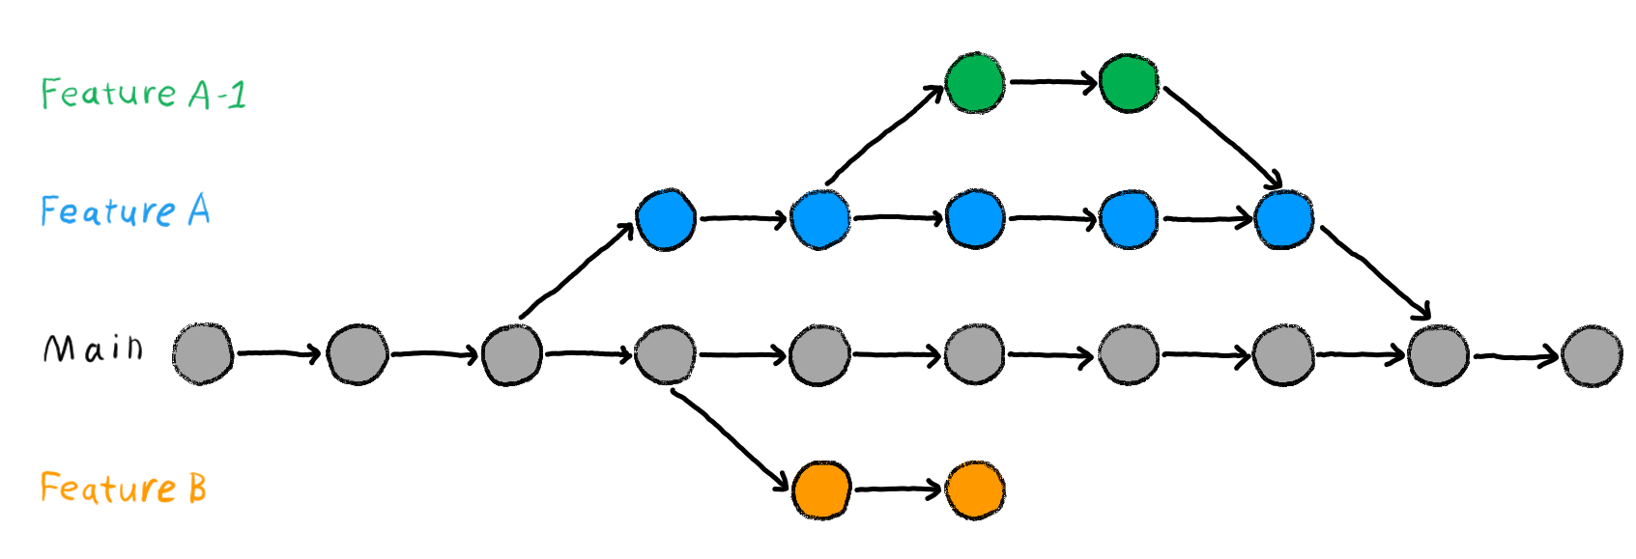
8. Switch to, create, delete, and rename branches.
Command | Description
git checkout -b new-branch | Create a New Branch.
git checkout branch-name | Switch to a Branch In Your Local Repo.
git branch -d branch-name git branch -D my-branch-name | Delete Branches. The -d option only deletes the branch if it has already been merged. The -D option is a shortcut for --delete --force, which deletes the branch irrespective of its merged status.
git branch -m old-name new-name | Rename Branch.

Slide 11
9. Git Log, Git Log --online
Description:
View the commit history in detail or simplified format.
Command:
git log | Show commit history of are repository and detailed information like commit hash, author, date, and commit message. Reviewing Commit History, Debugging
git log --online | Displays each commit on a single line, showing only the abbreviated commit hash and the commit message Quick Overview, Simplified View

Slide 12
10. Update Local Repository
Description:
Fetch updates from the remote repository and merge them into your local branch.
Command:
git fetch origin | Downloads commits, files, and references from a remote repository into your local repository.
git merge origin/<name-branch> | Merge the fetched changes into your local branch
git pull git pull origin main | Combines git fetch and git merge in one step, updating your working directory and current branch.

Slide 13
11. Git Pull vs Git Pull Rebase
Description:
Compare the standard pull with rebase to avoid unnecessary merge commits.
Command:
git pull origin main | Combines git fetch and git merge in one step, updating your working directory and current branch.
git pull –-rebase origin main | Fetches changes from the remote repository and re-applies your local commits on top of the fetched changes.
pull
Feature
A
B
C
F
Main
1
2
D
E
rebase
Feature
A
B
C
Main
1
2
D
E

Slide 14
12. Rebase Benefits:
Reapply your local commits on top of the downloaded commits, as if you made them after the changes from the server.
This results in a cleaner, linear commit history without the additional merge commits that a regular git pull would create.
Feature
A
B
C
Main
1
2
D
E
Feature
A
B
C
Main
1
2
D
E

Slide 15
13. How rebase code without using git pull –-rebase?
Description:
Manually rebase your code without using git pull --rebase
Command:
git fetch origin | Fetch the latest changes from the remote repository
git rebase origin/main | Rebase your current branch into the fetched changes Replace main with the name of the branch you are rebasing into.

Slide 16
14. Create Commit
Description:
A commit is a snapshot of the state of the project at a specific time, git saves changes to each file, allowing you to revert to this version if needed.
Command | Description
git commit -m "commit message"​ | Create a new commit. Each commit includes: A unique identifier: A SHA-1 hash that ensures the commit’s integrity and uniqueness. A commit message Metadata: Information such as the author, timestamp, and parent commit(s).
Master/Main
1
2
D
E
F
commits

Slide 17
15. Update Commit Message
Description:
A commit is a snapshot of the state of the project at a specific time, git saves changes to each file, allowing you to revert to this version if needed.
Command | Description
git commit --amend –m “New commit message” | Change the message of the most recent commit.
git rebase -i HEAD~N | Start an interactive rebase Replace N with the number of commits you want to go back. Change pick to reword for the commit you want to rename, then save and close the editor. Git will prompt you to edit the commit message.

Slide 18
16. Undo Commit
Command | Description
git reset --soft HEAD~1 | Soft: To undo the most recent commit but keep the changes
git reset --hard HEAD~1 | Hard: To undo the most recent commit and discard the changes
git revert <commit_hash> | Revert the commit: To revert a commit (create a new commit that undoes the changes)
git rebase -i HEAD~N | Delete an older commit, use interactive rebase Replace N with the number of commits you want to go back. Remove the line corresponding to the commit you want to delete.

Slide 19
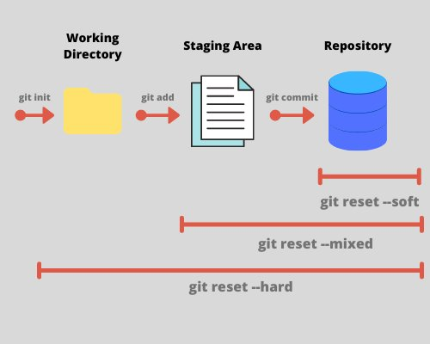
17. Soft and Hard Resert
Description:
Soft reset keeps changes in the working directory.
Hard reset discards them.
Command:
git reset --soft HEAD~1
git reset --hard HEAD ~1
Soft reset is useful for undoing changes, while hard reset is useful for completely undoing changes.

Slide 20
18. Git Merge
Description:
Merge changes form one branch into another.
Command:
git merge branch-name
Feature
A
B
C
Main
1
2
D
E
F

Slide 21
19. Git Squash
Description:
Combine multiple commits into one.
This is often done to clean up a commit history before merging a feature branch into the main branch.
But we lose the fine details of individual feature commits in the main branch commit history.
Command:
git squash branch-name
Feature
A
B
C
Main
1
2
D
E
F

Slide 22
20. Git Rebase --interactive
Description:
Using git rebase -i (interactive rebase) allows you to rewrite commit history in a flexible way.
git rebase -i HEAD~n // Replace N with the number of commits you want to rebase or reorder.
Command:
After running the command, your default text editor will open with a list of commits. Each line starts with a command (pick by default) followed by the commit hash and message. You can change pick to:
squash (or s): Combine multiple commits into one.
edit (or e): Pause to edit the commit.
reword (or r): Change the commit message.
fixup (or f): Like squash but discard this commit’s message.

Slide 23
21. Cherry Pick
Description:
Apply changes from a specific commit to your current branch.
Allow you select individual commits to be integrated.
Command:
git Cherry-pick commit-id
Branch A
1
2
3
Example
Branch B
1
2
3
E
For example, you can use cherry pick when committed on the wrong branch.

Slide 24
22. Git Reflog
Description:
It records updates to the HEAD and allows you to recover lost commits or undo changes.

Slide 25
23. Push / Push -f
Description:
Push your commits to the remote repository.
Use –f to force push.
Command:
git push origin main
git push -f origin main

Slide 26
24. Amend (Add Files)
Description:
Modify the most recent commit to include additional changes.
Using git amend:
Make your changes to the files in your local repository.
Stage the changes you want to amend using the "git add" command.
git add file1.txt, file2.txt
Run the "git amend" command:
git commit --amend
Command:

Slide 27
25. Merge vs Fast-forward Merge vs Rebase
Merge:
Standard Merge: Combines the histories of two branches, creating a new commit called a “merge commit” that has two parent commits.
Fast-forward Merge: Occurs when the branch being merged has not diverged from the target branch. Instead of creating a new commit, Git simply moves the branch pointer a linear sequence of commits.
Rebase:
Moves or combines a sequence of commits to new base commit. This rewrites the commit history, creating a linear sequence of commits.

Slide 28
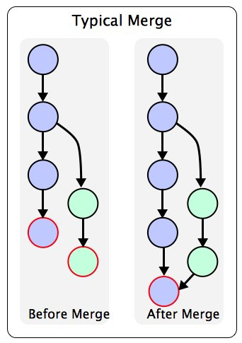
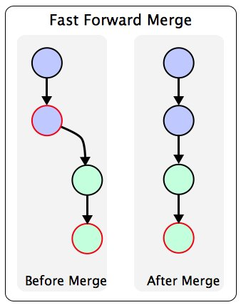
26. When does a fast-forward merge occur?
Fast-forward merge is only possible if the target branch is an ancestor of the source branch, which is usually not the case.

Slide 29
27. When is a fast-forward merge not possible?
A fast-forward merge is when no commits have been added to the master branch after the feature branch was created, meaning that the HEAD of master is the ancestor of the feature branch.​
If commits have been added to the master branch after the feature branch was created, then a fast-forward merge cannot be done.
In this case, a normal merge must be done and any conflicts that may arise must be resolved.​
git merge --ff-only <branch-name> | The --ff-only option ensures that Git will only perform the merge if it can be done as a fast-forward. If a fast-forward merge is not possible, Git will abort the merge and display an error message.

Slide 30
28. What is the result to the “main” branch after a non-fast-forward merge?
After a non-fast-forward merge, the “main” branch will have a new merge commit that combines the histories of both branches. This merge commit will have two parent commits, representing the tips of the branches being merged.

Slide 31
29. What to do when a conflict occurs?
When a conflict occurs during a merge or rebase, Git will pause the process and mark the files conflicts. You will need to manually resolve these conflicts before you can complete the merge or rebase.
How to resolve conflicts?
Identify Conflicts: Git will mark the conflicted areas in the files with conflict markers (<<<<<<, =====, >>>>>>>).
Resolve Conflicts: Edit the files to resolve the conflicts. Decide which changes to keep and remove the conflict markers.
Mark as Resolved: Once conflicts are resolved, mark the files as resolved using, git add <file>.
Continue the Process: If you were merging, complete the merge with git commit. If you were rebasing, continue the rebase with git rebase –continue

Slide 32


Gracias
Armando
Antonio

